Slide 1
Predictive Model Analysis for SyriaTel
By Alec Mills

Slide 2

Outline
Business Problem
Data
Results
Summary
Questions
Notes:
I will talk to you about our business problem, data analysis and results and take you through my Summary.

Slide 3
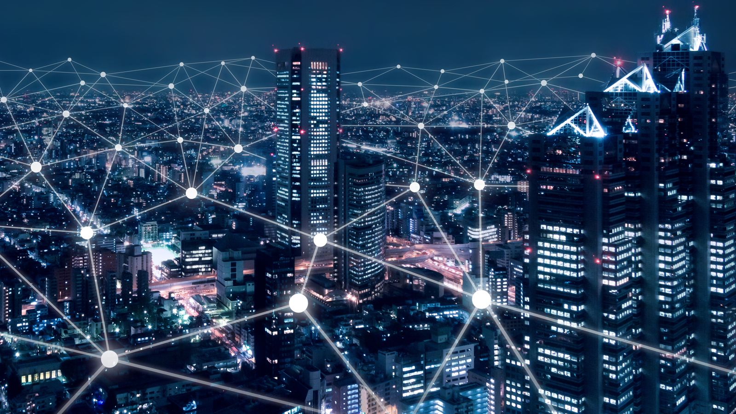
Business Problem
SyriaTel
Saving the company money
Keeping customers longer
Notes:
Our Business Problem is to save SyriaTel Money by using the data to predict customer churn. And to give suggestions on how to have keep people longer.

Slide 4
15%
Loss of customers base.
Notes:
The reason we are looking into this problem is because SyriaTel has lost ~ 15 percent of its customer base. Resulting in a loss of 31,567$.

Slide 5
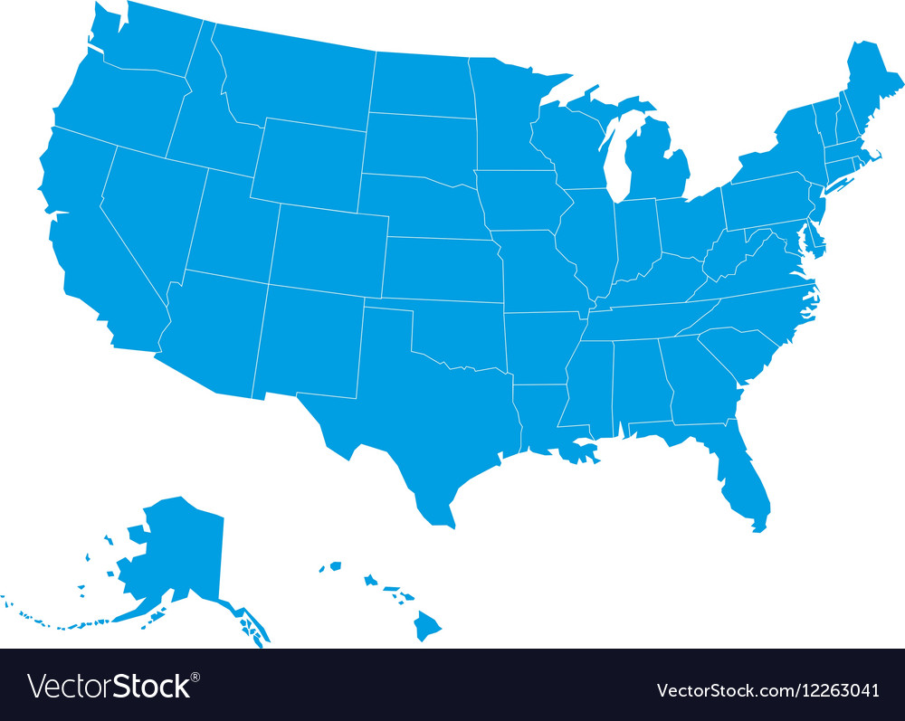
Data - Telecom data set in the US
Notes:
We used roughly 3,500 data points of the SyriaTel data set based out of the US, to make our predictions and conclusions.

Slide 6
Final Model
95% Accuracy Score
72% Recall Score
Notes:
Looking into our results we have found average churned customers Paid 7 more $ than no churned customers. The only time of day that was seen to be higher was during the Day and evening. Of the ~ 9% of customers that did have an international plan 42% churned. And of customers that Do have a Voicemail plan only ~8% churn.

Slide 7
Results
Total Charge
International Plan
Voicemail Plan
Total Day Charge
Total Evening Charge
Only 9% of our customer base
Only 28% of our customers.
Notes:
Looking into our results we have found average churned customers Paid 7 more $ than no churned customers. The only time of day that was seen to be higher was during the Day and evening. Of the ~ 9% of customers that did have an international plan 42% churned. And of customers that Do have a Voicemail plan only ~8% churn.

Slide 8
Summary
The problem
Problem
Results
Recommendations
15% of customer base
Using our predictive model how can we lower the rate of customer Churn
Voicemail Plan
International Plan
Customers charged higher during the day and Evening
Include Voicemail plans in the price
Give discounts to International Plan
Change to a flat rate

Slide 9
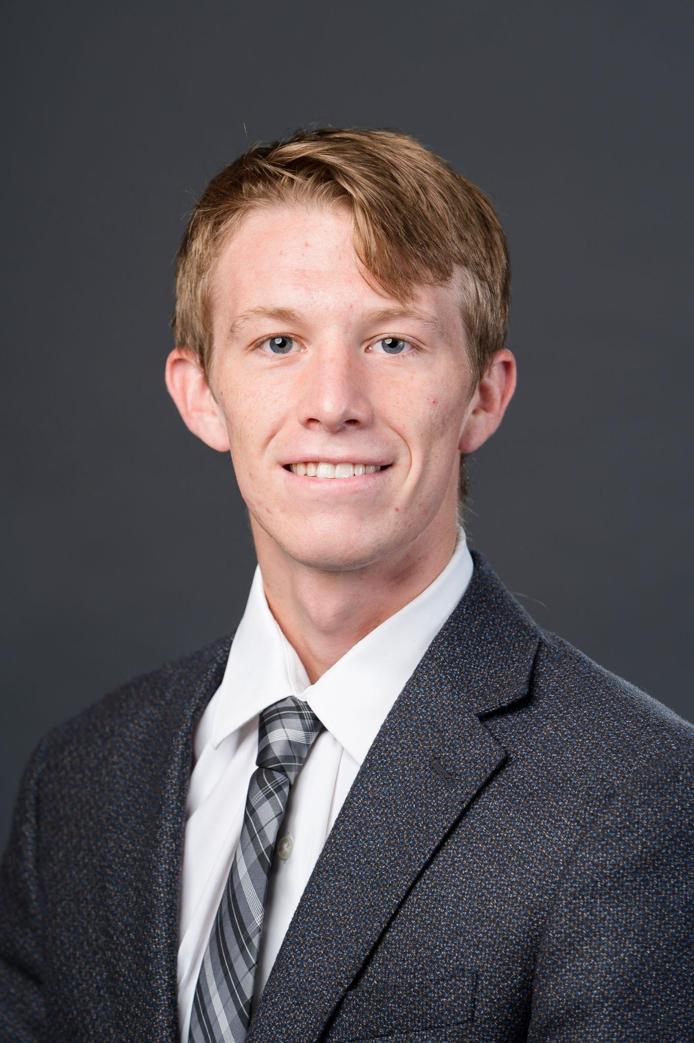



Questions?
Alec Mills
Notes:
Thank you everyone and if you have any questions now is the time for those

